Slide 1
Classification of Pneumonia-Related Diseases Using Chest X-Ray Images
Author: Ken Trinh, Trevor Dalton, Sudhir Suvva
W281 - Computer Vision
Section 3
Spring 2023
Notes:
Trevor

Slide 2
Problem Statement:
Are there any features that we can learn through a combination of image processing and machine learning to better detect Pneumonia patients’ chest X-ray?
Notes:
Trevor

Slide 3
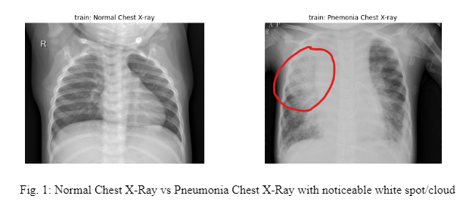
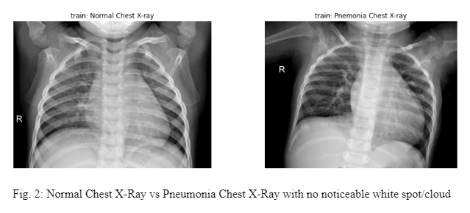
Data Overview
Notes:
Trevor

Slide 4
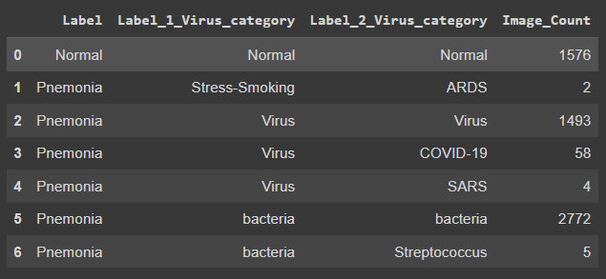
Classes of Images
Notes:
Trevor

Slide 5
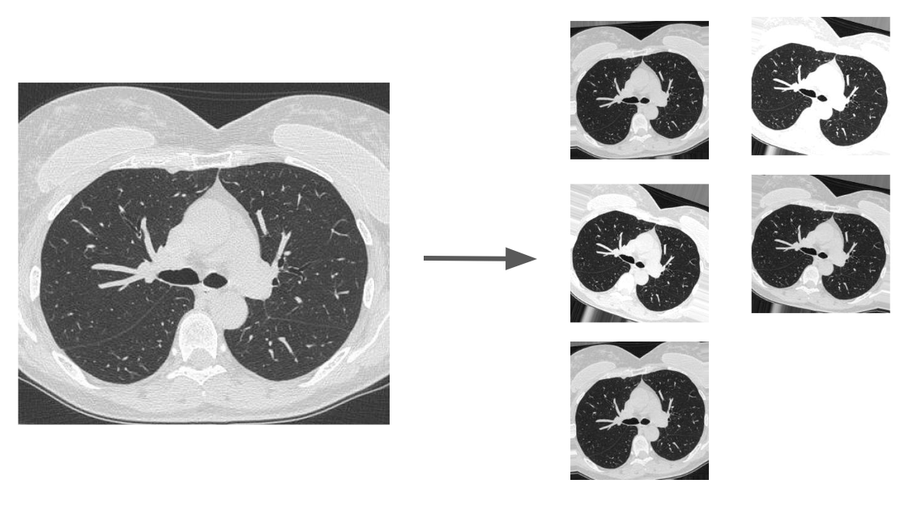
Data Augmentation
Ranges of Augmentation:
Rotation: 0-20 degrees
Shear: up to 0.05x
Zoom: up to 0.05x
Illumination: 0.75-1.25x
Notes:
Trevor

Slide 6
Feature Engineering
HSV histogram: Identifies if the classes can be distinguished from each other by distribution of coloring alone.
Local Binary Pattern (LBP): helps in understanding the local representation of the texture of an image.
Scale Invariant Feature Transformation (SIFT): It is used to identify distinctive features from the images and used to apply for matching irrespective of the image scaling, rotation and translation.
Notes:
Trevor

Slide 7
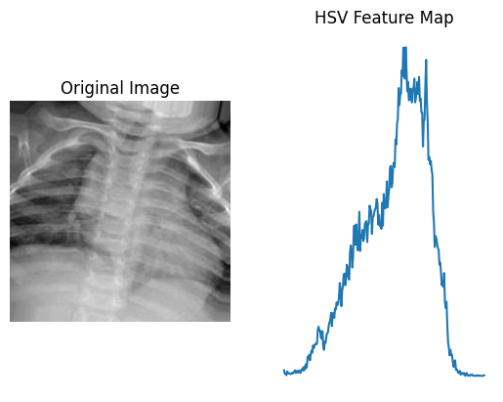
HSV Histograms
Seeing as sick patients usually exhibit the aforementioned “white-cloud” in their lungs, creating a histogram of pixel intensities for each image is a simple, yet strong, feature we can use to diagnose with
The downside of this feature is that it throws away all spatial information which may be insightful for diagnosis
Notes:
Trevor

Slide 8
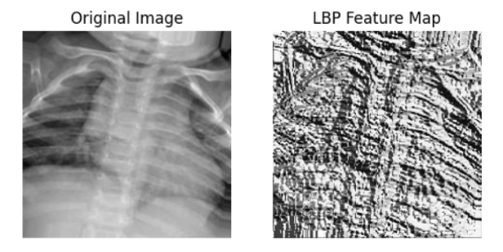
LBP Features
Extracts the local representation of the texture of an image.
Create textures for the image to distinguish between human anatomical structures and “white-cloud”

Slide 9
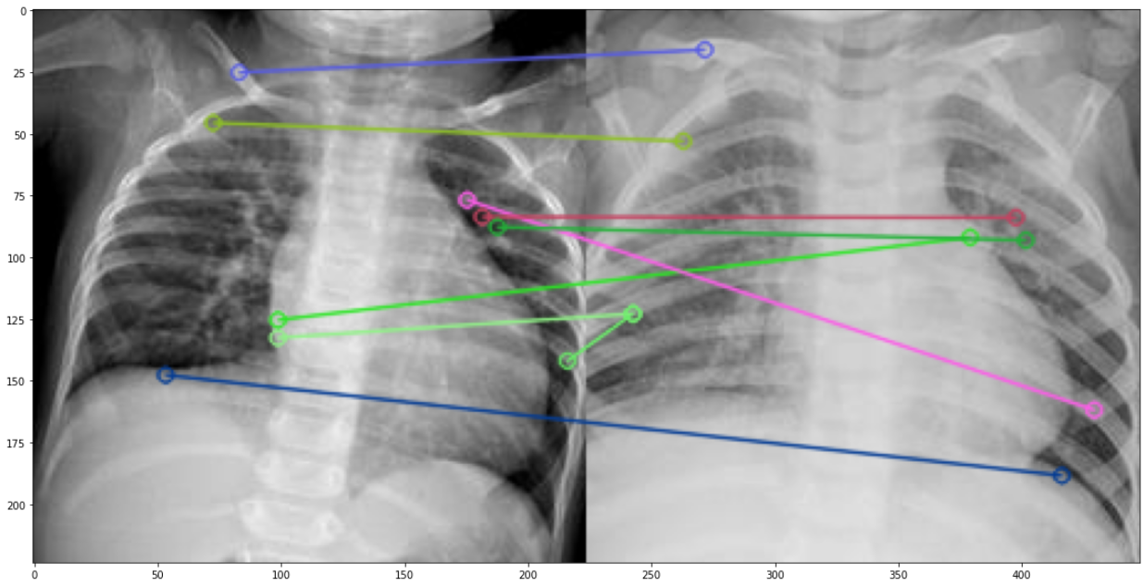
SIFT Feature Pneumonia Patient Detection
Matching of a “non-white cloud” pneumonia patients (left) vs a “white cloud” pneumonia (right) patient.
Notes:
Ken

Slide 10
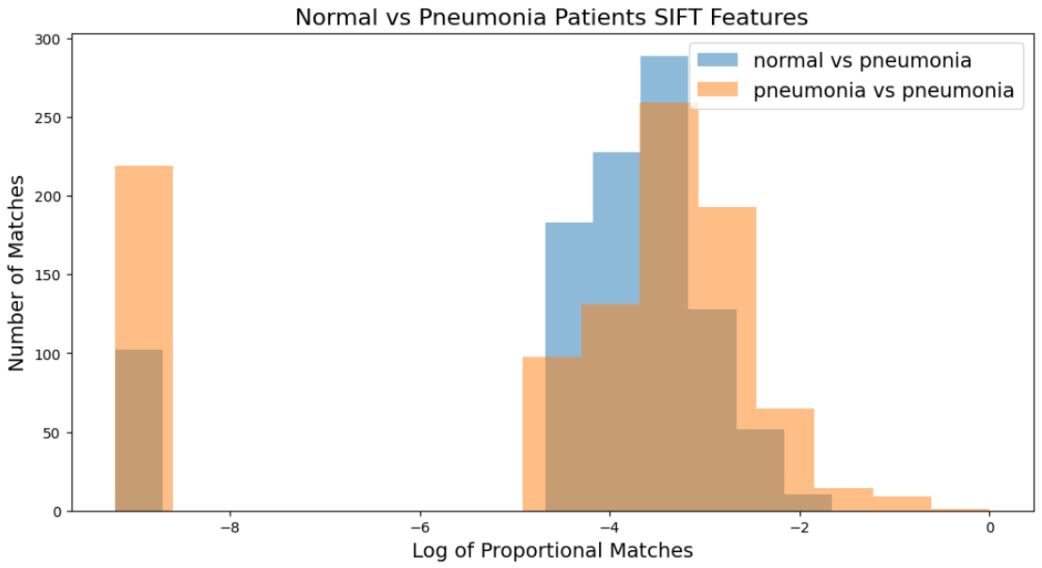
SIFT Features - Hypothesis Testing
Test Performed on 1000 image pairs per set:
Normal vs pneumonia x-rays
Pneumonia vs pneumonia x-rays
Two samples t-test is perform:
Null Hypothesis:
Average matches between two samples are the same
Alternative hypothesis:
Average matches between two samples are not the same
P-value < 0.05; suggesting that there is enough evidence to reject the Null Hypothesis
Normals vs Pneumonia SIFT Variance | 3.262
Pneumonia vs Pneumonia Variance | 6.445
p-value | 2.58e-5
Notes:
Ken

Slide 11
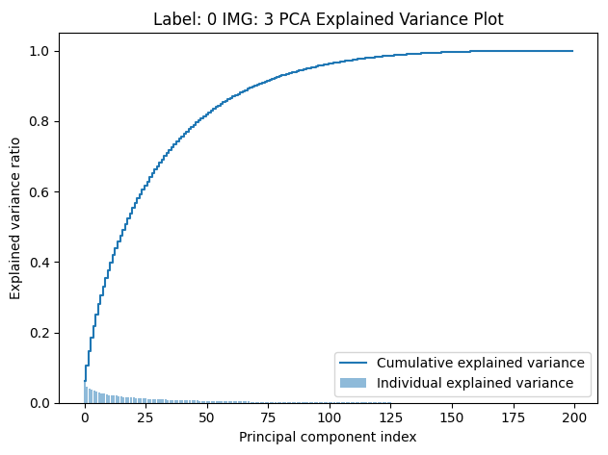
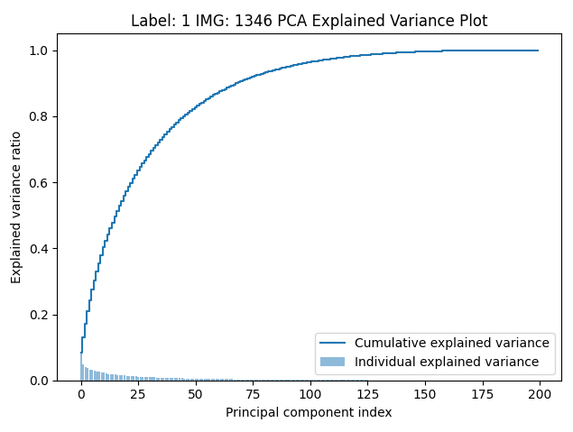

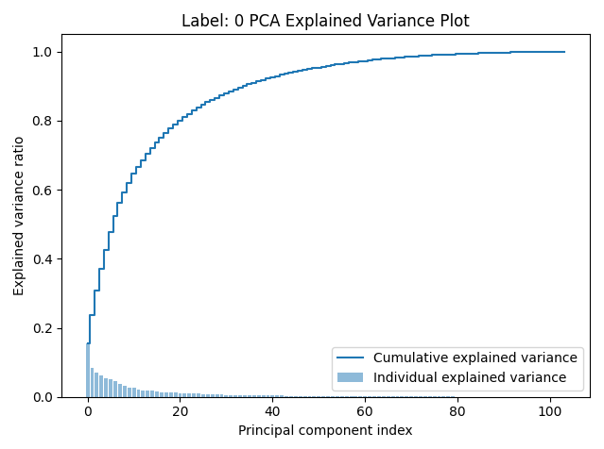
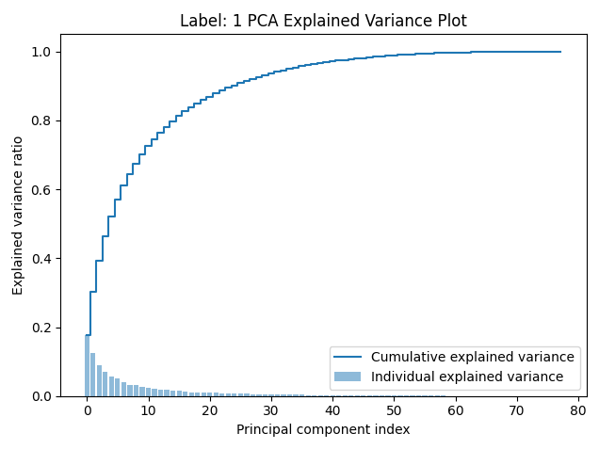

Feature PCA - Explained Variance Plots
Notes:
Ken

Slide 12
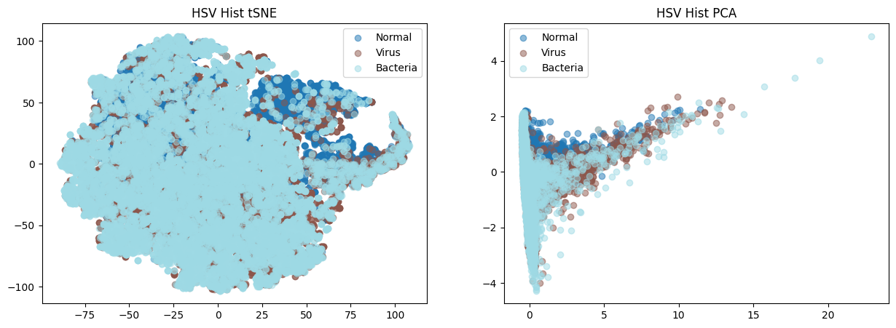
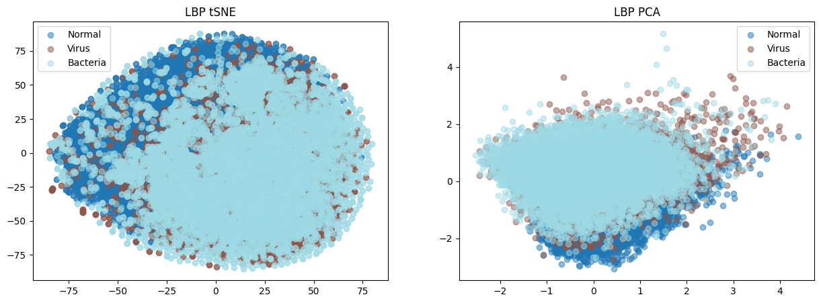
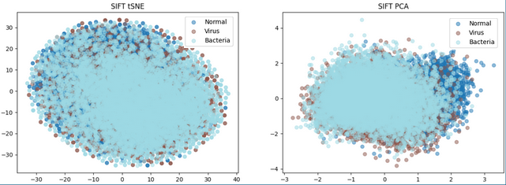
Feature tSNE vs PCA
Notes:
tSNE on LBP description features does not provide enough distinguishable information at t = 2 components compared to PCA
However time spent on tSNE might be saved when used in modeling

Slide 13
Modeling

Slide 14
Table of Contents
Convolutional Neural Network (Current SOTA)
Logistic Regression
Support Vector Machine Classifier
Gradient Boosting Classifier
autoML
Notes:
Sudhir

Slide 15
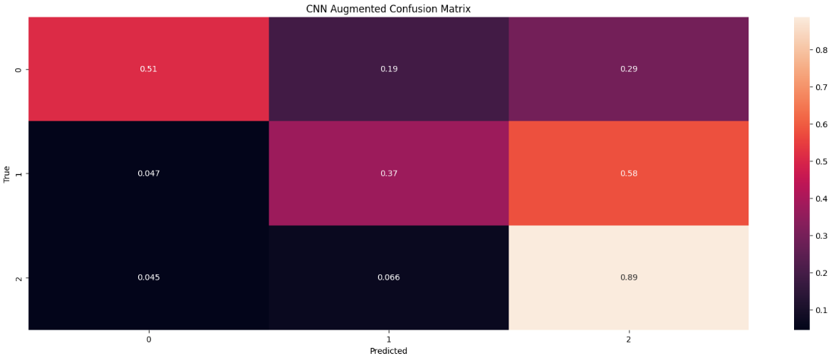
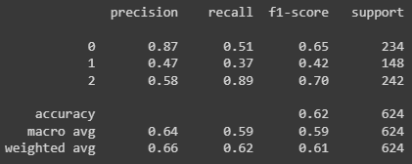
Baseline CNN - Model Results
Notes:
Sudhir

Slide 16
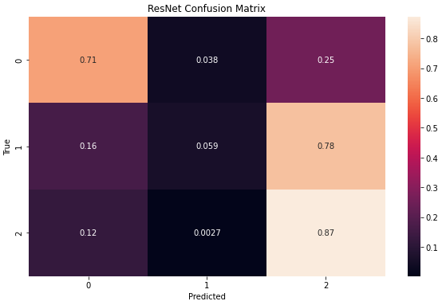
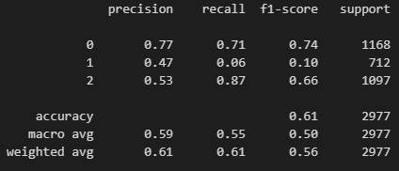
ResNet50 Outputs

Slide 17
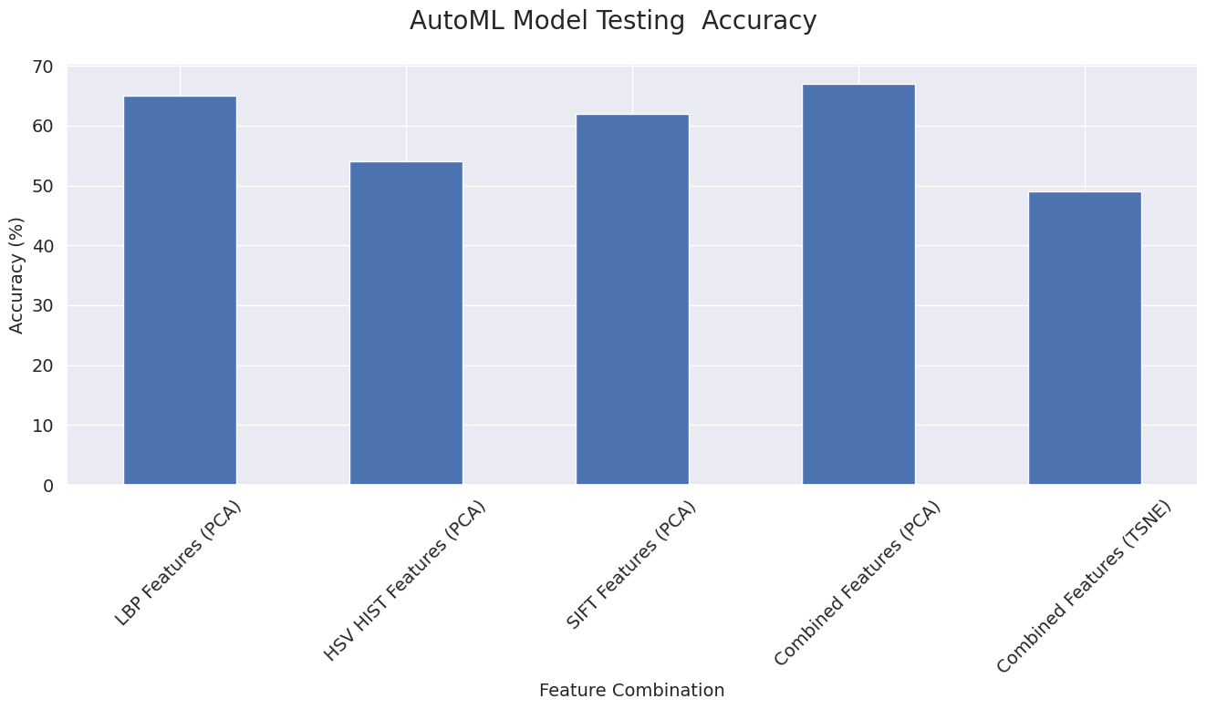
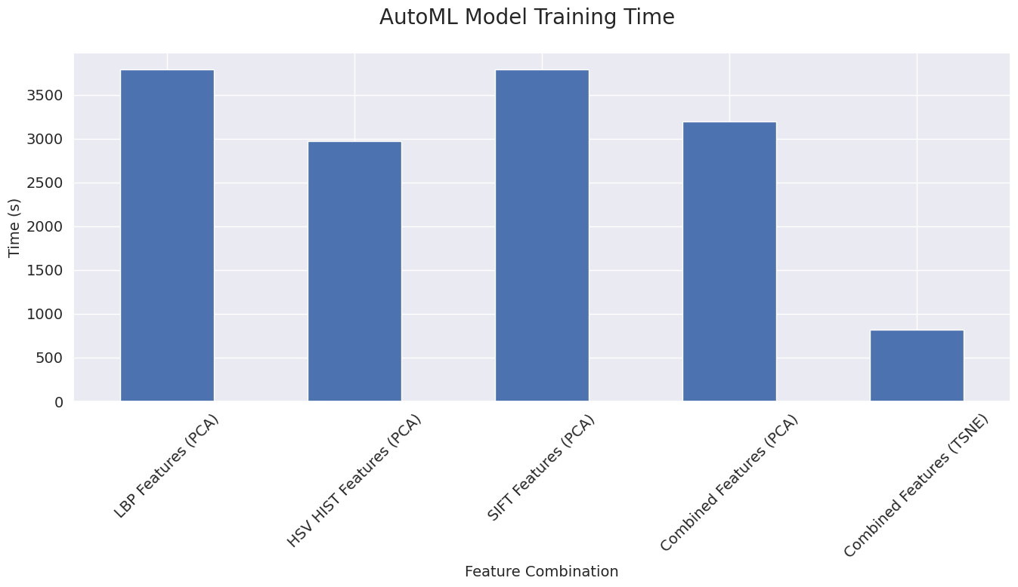
Efficiency - Accuracy Trade Off
Using best model (autoML)
Model with better accuracy could mean higher training cost
Measurement taken in seconds for best model overall (autoML and CNN)
Notes:
Sudhir

Slide 18
Conclusion
Individual features and combined features capture a little more information when compared to the modern CNN approach
ResNet50 fine-tuning did could not distinguish viral vs bacterial infected patient
Could be due to poor X-ray quality
AutoML provide marginal positive effect compared to GBT
The extracted features were not able to fully able to capture the “white-cloud” effect on pneumonia patients
TSNE only contribute to model training efficiency but low accuracy
Notes:
Sudhir

Slide 19
One More Thing

Slide 20
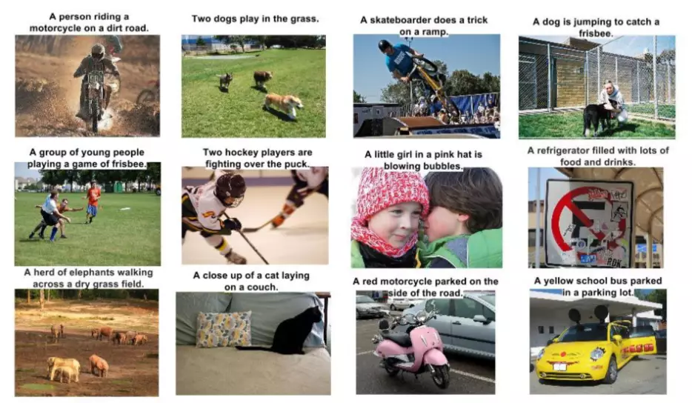
What If - We Treat This As An Image Captioning Problem?

Slide 21
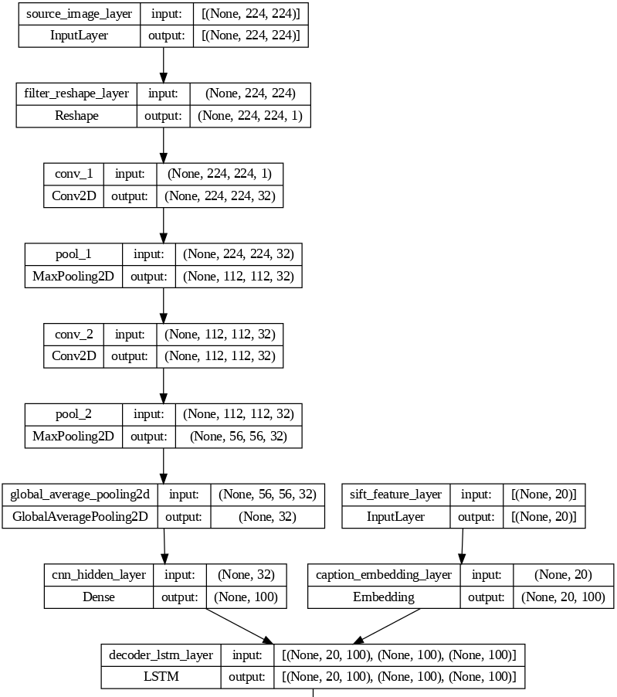
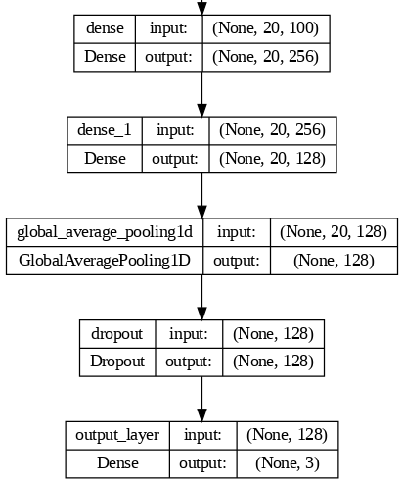
CNN with LSTM SIFT Feature Architecture

Slide 22
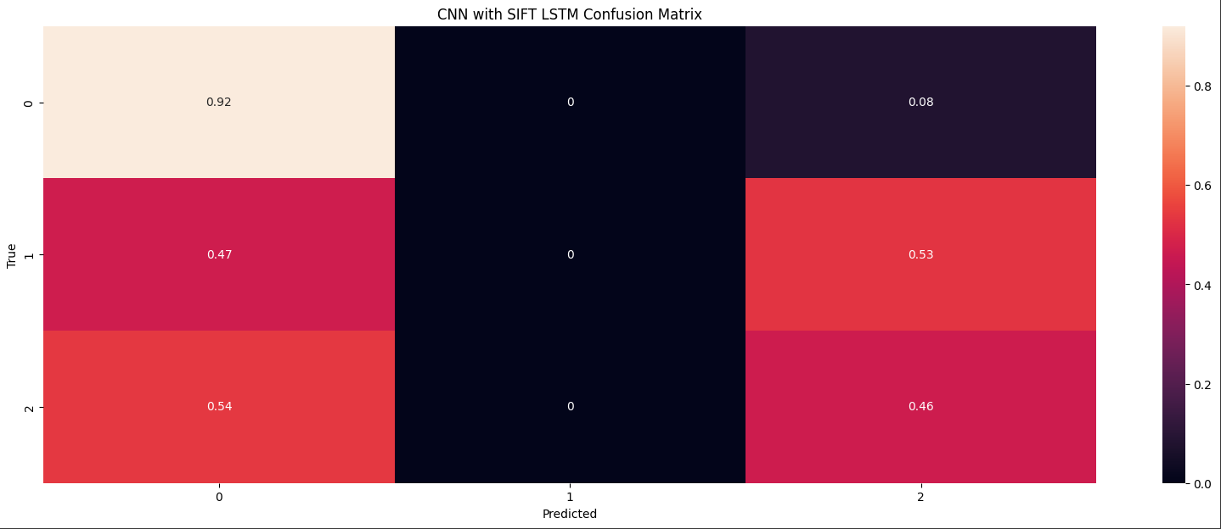
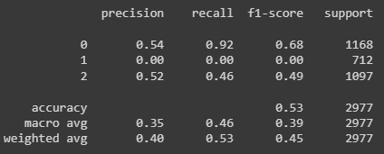
CNN with LSTM SIFT Feature - Model Results

Slide 23
Conclusion
Bigger, more complex, model is not always better
More features could be use as initializer for LSTM.
Usage of Attention could help capture some additional effect

Slide 24
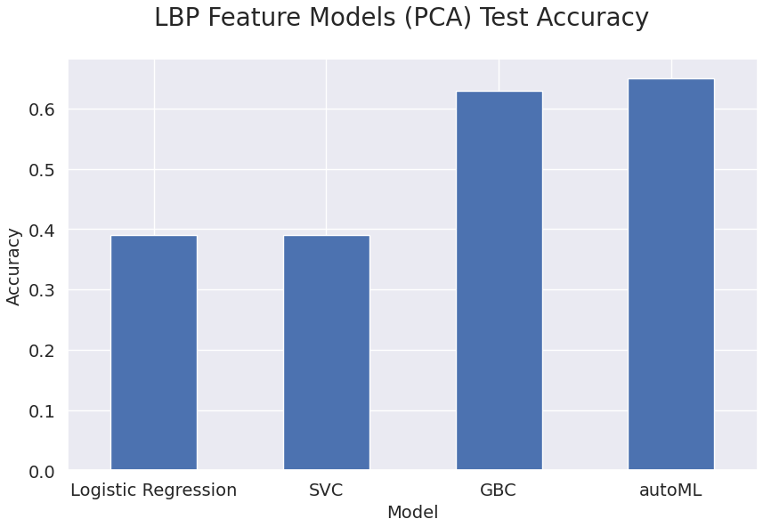
LBP Features Model Results
autoML Best model architecture:
Model | Weight
16_CatBoost_SelectedFeatures | 2
19_RandomForest_SelectedFeatures | 1
22_Neural_Network | 1
23_Neural_Network | 1
28_Xgboost_GoldenFeatures | 1
29_Xgboost_GoldenFeatures | 1
45_Xgboost_GoldenFeatures_Selected_Features | 1
Notes:
Sudhir

Slide 25
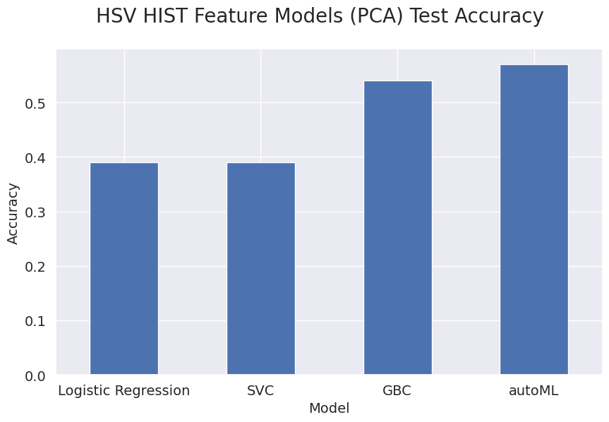
HSV Features Model Results
Model | Weight
13_LightGBM | 1
16_CatBoost | 2
17_CatBoost | 2
22_NeuralNetwork | 3
24_NeuralNetwork_GoldenFeatures | 1
25_NeuralNetwork | 1
26_CatBoost | 1
29_NeuralNetwork | 2
38_RandomForest | 1
40_NeuralNetwork | 1
Notes:
Sudhir

Slide 26
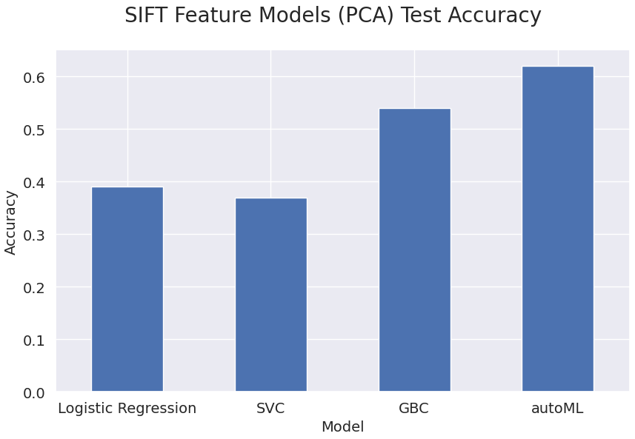
SIFT Features Model Results
autoML Best model architecture:
Model | Weight
11_lightGBM | 1
14_CatBoost | 1
16_CatBoost_SelectedFeatures | 1
23_NeuralNetwork | 1
24_NeuralNetwork | 1
2_Default_Xgboost | 1
34_NeuralNetwork | 1
37_NeuralNetwork | 1
49_NeuralNetwork | 2
8_Xgboost_SelectedFeatures | 1
Notes:
Sudhir

Slide 27
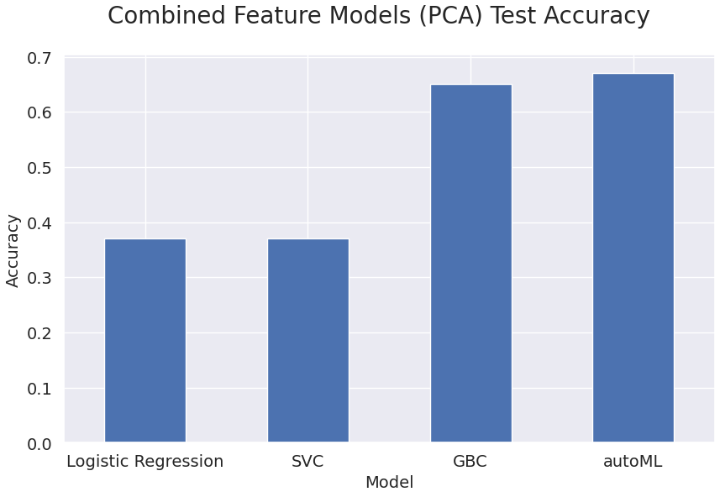
Combined Features Model Results
autoML Best model architecture:
Model | Weight
13_LightGBM_GoldenFeatures | 1
22_NeuralNetwork_SelectedFeatures | 1
26_Xgboost | 1
43_Xgboost | 1
45_Xgboost | 1
4_Default_NeuralNetwork | 1
53_NeuralNetwork | 1
Notes:
Sudhir

Slide 28
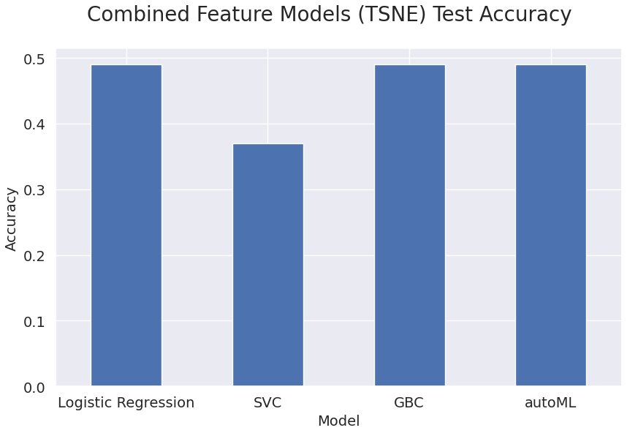
Combined Features Model Results
autoML Best model architecture:
Model | Weight
1_Default_LightGBM | 2
27_Xgboost | 1
29_Xgboost | 1
39_NeuralNetwork | 1
41_Xgboost | 1
42_Xgboost | 1
43_Xgboost | 4
44_Xgboost | 2
8_Xgboost | 1
9_Xgboost | 3
Notes:
Sudhir

